Slide 1
COVID-19 vaccination
children 5-11 years
Adam Mezoff MD, CPE, NASPGHN-F
chief medical officer
VP for medical affairs and health care transformation

Slide 2
agenda
1 vaccination background 3 Pfizer’s vaccine trials
2 COVID-19 cases in children 4 getting your child vaccinated

Slide 3
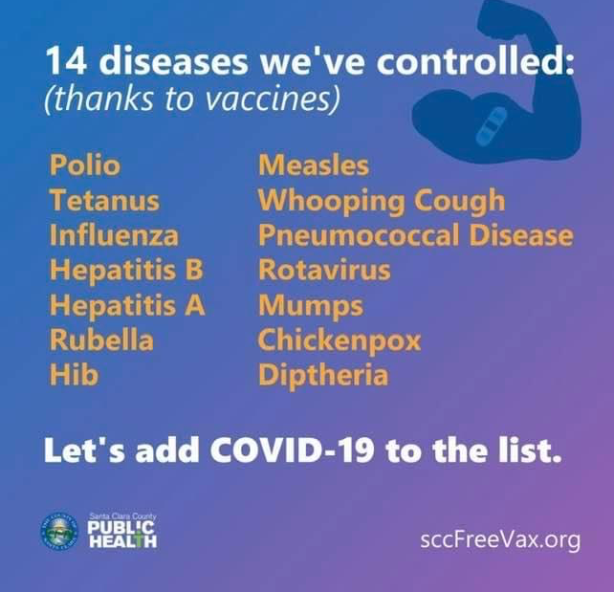
vaccines
New things can be scary, especially when so much is unknown.
Remember that vaccination is not new – it has helped humans fight infectious diseases for centuries.
New things can be scary, especially when so much is unknown.
Remember that vaccination is not new – it has helped humans fight infectious diseases for centuries.
14 diseases we’ve controlled:
(thanks to vaccines)
Polio
Tetanus
Flu
Hepatitis A and B
Rubella (German measles)
Hib
HPV
Meningitis
Measles
Whooping cough
Pneumonia
Rotavirus
Mumps
Chickenpox
Diphtheria
Let’s add COVID-19 to the list.

Slide 4
mRNA vaccines
how it works
M stands for messenger.
RNA is like a blueprint that tells your cells how to make proteins.
mRNA vaccines duplicate the instructions for making the COVID-19 spike – just the spike.
Your body’s cells make more spikes.
The immune system makes antibodies to kill the spikes, which is sometimes why you feel a little sick after a vaccination – it’s a good immune response!
Now your body has a system in place to kill the COVID-19 virus faster than it would if your body was experiencing it for the first time.

Slide 5
mRNA vaccines
important facts
Researchers have been working with mRNA vaccines for decades.
This is just the first time they have been used on the mass market.
Cancer research has used mRNA to trigger the immune system to target specific cancer cells.
mRNA cannot do any damage.
It is destroyed shortly after entry.
It can’t change your DNA.
The spike protein is not alive.
It cannot give you COVID-19.
It is a safe and effective way to vaccinate.

Slide 6
COVID-19 cases in children

Slide 7
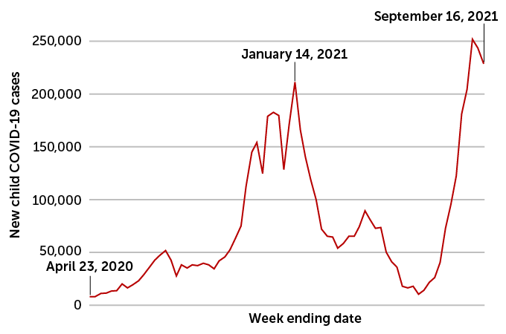
how common is COVID-19 infection in children?
United States
Due to the more contagious delta variant, COVID-19 is now a disease that impacts children.
In September, we saw a record surge of cases in children.
This was higher than the surge we saw in the winter months.
Next variants could be even more dangerous to children, as the virus looks for unprotected hosts.
Notes:
National data showing the back-to-school surge
What is the source – need to update this graph

Slide 8
how common is COVID-19 infection in children?
according to the American Academy of Pediatrics:
Approximately 1/4 of all the COVID-19 cases in the country are in children. (24.8% as of October 7)
Kids only make up about 1/5 of the population. (22.2%)
Notes:
National data showing that children are now a higher percentage of the total reported cases.
https://www.aap.org/en/pages/2019-novel-coronavirus-covid-19-infections/children-and-covid-19-state-level-data-report/

Slide 9
how sick do children get?
hospitalizations
Overall 2% of children with COVID-19 in Ohio have had to be hospitalized.
The delta variant has caused a recent surge.
In September, more children had to be hospitalized than any month prior.
October is trending lower.
Notes:
Ohio data on hospitalizations

Slide 10
how sick do children get?
Nearly one third of adolescents who had to be hospitalized for COVID-19 required intensive care.
One in twenty of those hospitalized require intubation (a tube placed down the child’s throat connected to a machine that helps them breathe).
1/3
1/20
Havers FP, MMWR. 2021;70:851–7.
Murthy BP. MMWR 2021;70:1206–1213
Notes:
ICU and vents

Slide 11
how sick do children get?
14 children have died in Ohio from COVID-19
virus | pediatric deaths per year | time span
COVID-19 | 658 | January 1, 2021– October 3, 2021
Influenza (flu) | 110 – 192 | 2016-2020 (yearly vaccine reduces numbers)
Varicella (chickenpox) | 50 | 1970 – 1994 (now controlled by vaccine)
Rotavirus (intestinal illness) | 20-60 | 1999-2007 (now controlled by vaccine)
Rubella (German measles) | 17 | 1966-1968 (now controlled by vaccine)
Notes:
Deaths
https://coronavirus.ohio.gov/wps/portal/gov/covid-19/dashboards/key-metrics/mortality - source for the number of child deaths in Ohio
https://covid.cdc.gov/covid-data-tracker/#demographics – source for US pediatrc deaths

Slide 12
Pfizer’s vaccine trials

Slide 13
vaccine trials in children ages 5-11
Children have different immune systems from adults.
Knowing this, Pfizer tested varying doses in trials of children 5 to 11.
Kids, it turns out, have a strong immune response even to lower doses.
This trial used a 10-microgram dose. Those 12 years and older received a 30-microgram dose.
The trial included:
2,268 participants ages 5 to 11
Two-dose regimen of the vaccine
Administered 21 days apart

Slide 14
Is the COVID vaccine safe?
According to Dr. Robert Frenck, vaccine researcher, Cincinnati Children’s Hospital:
"If we haven't seen anything with the hundreds of millions of doses, we're not going to see anything -- so I think parents should feel comfortable that this vaccine has been given to…. hundreds of millions of people, and that it continues to show a very good safety profile.“
“Beyond the clinical trials now, we've given literally hundreds of millions of doses of vaccine to adults and teenagers throughout the country."

Slide 15
Does the COVID vaccine work?
YES!
The immune response in children 5-11 given the vaccine was similar to the response in children 12-17.
No children who have been vaccinated have been admitted to Dayton Children’s Hospital.

Slide 16
side effects of the vaccine in children 5-11
According to Dr. Robert Frenck, vaccine researcher, Cincinnati Children’s Hospital:
Side effects in children mirrored exactly what we saw in adults, lasting a day or two.
Most common:
Pain at injection site
Headache
Fatigue
Less common
Fevers
Chills

Slide 17
side effects of the vaccine in children 5-11
There have been reports of a rare heart inflammation called myocarditis with the second dose of both Moderna and Pfizer vaccines.
Myocarditis means swelling of the muscles of the heart.
The likelihood is a few per 100,000.
That’s about a 99.999% chance that this won't happen.
Cases have been almost all in teenage boys
Mild cases
Treated with ibuprofen
Children recovered

Slide 18
vaccine combinations
COVID-19 vaccines can be given at the same time as other vaccines, including the flu vaccine.
If you don’t feel comfortable with that, the COVID-19 booster should take priority right now.
When we begin to see flu in the community, the flu shot becomes more important.

Slide 19
should I get my child vaccinated?

Slide 20
reasons to get your child vaccinated
protecting your child
Limit preventable illness including hospitalization
Limit time out of in-person learning in school
Limit time out of extra-curricular activities
protecting your family
Limit spread to vulnerable family members
Grandparents
Chronic Illness
Cancer survivors or those being treated
protecting your community
Help to limit the chance of future variants
Keep schools and businesses open and thriving by limiting spread
Rid the community of the pandemic

Slide 21
Where can I get the vaccine?
STARTING NOVEMBER 1 (or when the FDA issues EUA approval)
Dayton Children’s main campus One Children’s Plaza, Dayton
Monday – Friday, 4:30 pm to 7:30 pm
Saturday, 9:00 am to noon
Dayton Children’s south campus 3333 West Tech Road, Springboro
Tuesday and Thursday, 4:30 pm to 7:30 pm
Ages 7 and up can go anywhere teens and adults can go
gettheshot.coronavirus.ohio.gov

Slide 22
Why can’t my child get the shot at school?
Safety
15-minute wait and watch period
Social distancing must be maintained
Parental involvement and consent
Parents should be present with a younger child
That’s not always possible during the school day
Resources
Give as many shots as possible in a short period of time

Slide 23
What else should I know?
Information sheets are on our website - childrensdayton.org
About the mRNA vaccine
Why should I get my child vaccinated and FAQs
Talk to your child’s pediatrician if you have questions
Prepare for the vaccination
Be honest - explain that shots can pinch or sting, but it won’t hurt for long.
Remind your child that vaccines can keep him or her healthy.
During the vaccination visit
Create distractions – ask them questions, tell a story, have them look at you and hold your hand.
Crying is okay – comfort your child and support them.
Take deep breaths with your child to help “blow out” the fear or sting.
After the vaccination
Reward your child for their bravery with hugs and smiles.

Slide 24
questions?

